Slide 1


Classification Project -
Red Wine Quality
Prepared by Rami Benhamo &
Shaked Rakach
Can we predict the quality of wine
based on its physicochemical
components?

Slide 2
Dataset & Features
Features
Dataset:
This dataset contains physicochemical data for 1,599 red wine samples from Portugal. It includes 11 input features that represent various chemical properties of the wines, along with one output variable (quality) derived from sensory evaluations.
Additional Notes:
The dataset contains no missing values. Duplicates represent multiple evaluations of each wine, included for consistency.
Fixed acidity
Volatile acidity
Citric acid
Residual sugar
Chlorides
Free sulfur dioxide
Total sulfur dioxide
Density
pH
Sulphates
Alcohol
Quality
Is High Quality (Target Value)

Slide 3
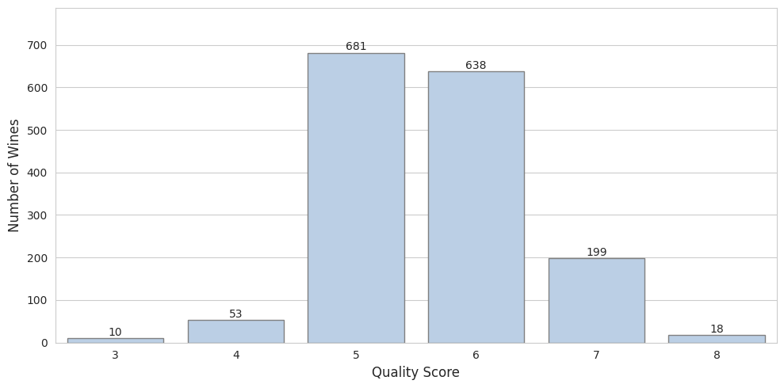
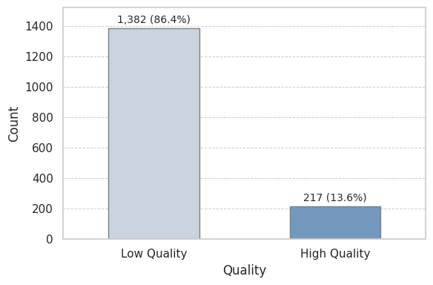
Distribution of Quality Scores
Target Variable:
The target variable, “quality,” is based on sensory evaluations rated on a scale from 0 to 10. In our dataset, the quality scores range from 3 to 8. We have converted these scores into a binary classification system: scores of 7 and above are classified as high quality (1), while scores below 7 are considered low quality (0). This threshold was selected to balance the number of samples while maintaining a high-quality standard.
Distribution of Target Value
Imbalance Data:
Our dataset shows a substantial imbalance between high and low-quality wines, with high-quality wines accounting for approximately 14% of the samples.

Slide 4
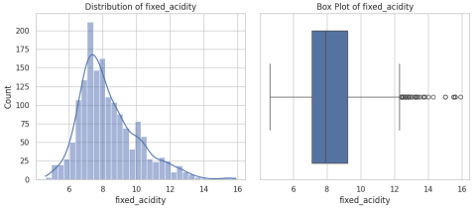
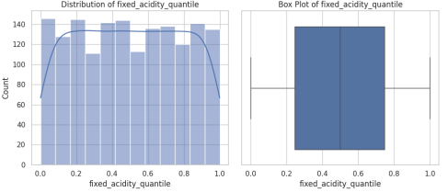
Data Preprocessing
To enhance our model's predictive power, we applied advanced feature transformations (like log, square root, and Yeo-Johnson) and utilized the SelectKBest method for selecting the most informative features. This streamlined process led to the creation of a new dataset, ‘Transformed Data’ capturing the optimally processed versions of our features. We will analyze the impact of these transformations on feature distributions and correlations.
Here is an example of how this transformation affected the distribution and outliers reduction of fixed acidity:
Original Data
Transformed Data
Outlier reduction: 45% (from 573 to 315 outliers in total)
Total outlier percentage decreased from 35.83% to 19.70%
6 features now have no outliers after transformation
Feature transformation significantly reduced outliers, potentially normalizing the dataset.

Slide 5
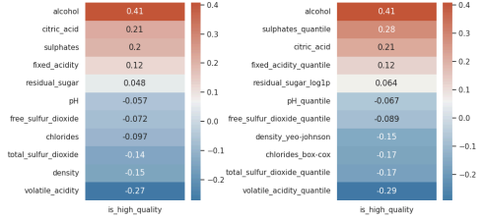
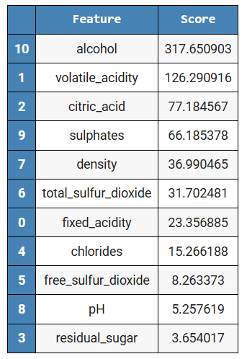
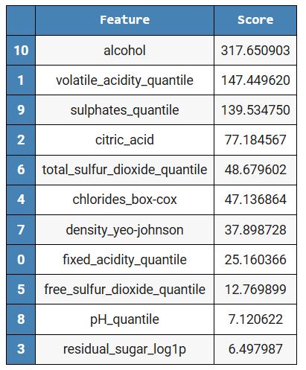
Correlation Analysis & Feature Importance
Correlation to Target Value Original vs Transformed
Correlation Analysis:
Feature transformations enhanced correlations with target column, refining relationships for improved model:
Sulphates rose from 0.199 to 0.283.
Residual sugar slightly improved from 0.048 to 0.064.
Negative correlations strengthened:
volatile acidity increased from -0.27 to -0.29, and total sulfur from -0.097 to -0.17.
Feature Importance SelectKBest scores:
Alcohol remains the most significant feature with a score of 317.65 (unchanged)
Volatile acidity: 147.45 (increased from 126.29)
Sulphates: 139.53 (increased from 66.19)
Citric acid: 77.18
Feature Importance Score Original vs Transformed

Slide 6
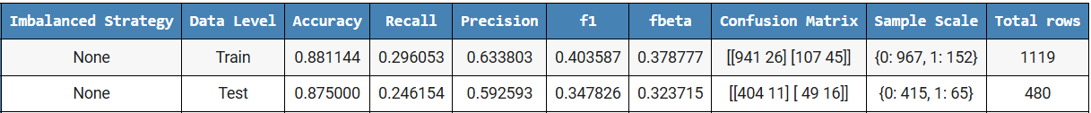

Methodology
Model Performance Progression
Evaluation Metric:
F1 Score Balances precision and recall.
Suitable for imbalanced datasets (14% high-quality wines).
Chosen over F-beta due to observed bias in predictions.
Imbalanced Data Handling
Compared strategies: None, under-sampling, oversampling, oversampling_75.
OverSampling_75 consistently outperformed other strategies.
Transformed data showed higher F1 scores with oversampling.
Model Optimization
Created pipeline with feature transformation and optimized oversampling.
Used Optuna for hyperparameter tuning.
Optimized Logistic Regression parameters and SMOTE sampling_strategy.
Achieved F1 score of 0.61 after 150 optimization trials.
Initial Logistic Regression: F1 score 0.3478
After feature transformation: F1 score 0.4314
With oversampling (75%): F1 score 0.5618
After Optuna optimization: F1 score 0.6104
Feature transformation and OverSampling_75 strategy consistently
improved model performance across various scenarios.

Slide 7
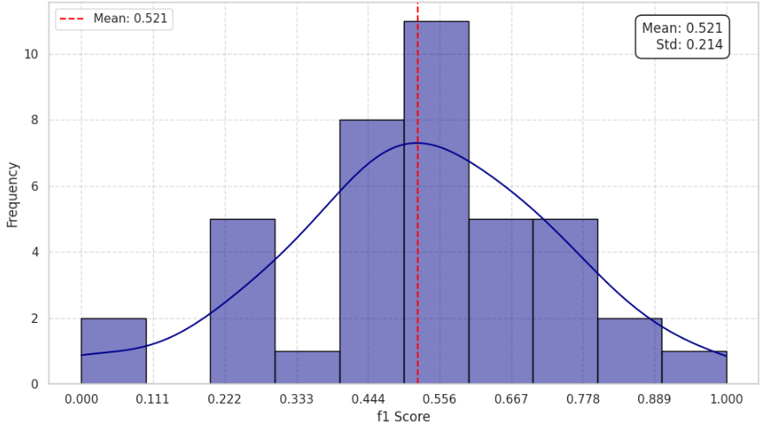
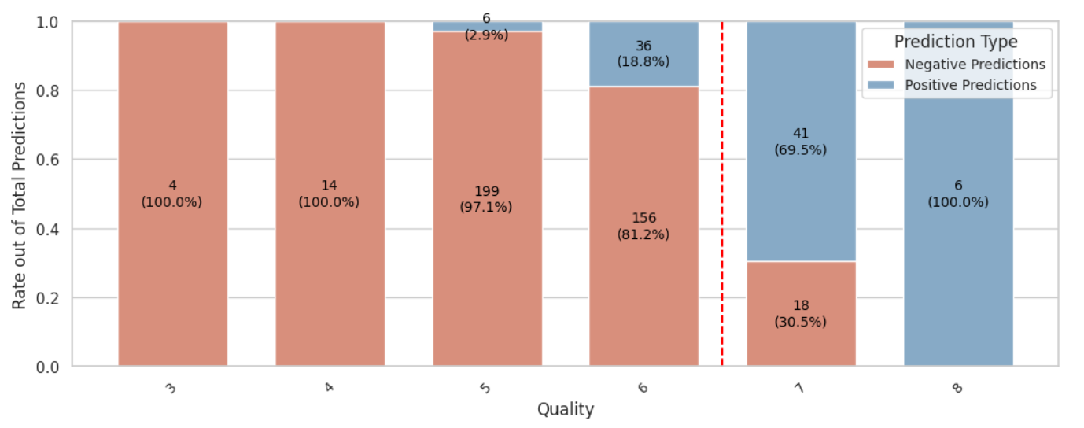
Cross Validation & Model Performance Analysis
Cross Validation Results:
40-fold cross-validation on training data
Mean F1 score: 0.521
High standard deviation: 0.214
Used StratifiedKFold for balanced class distribution
High variability in model performance across folds, indicating sensitivity to data subsets.
Model Performance by Quality Scores:
Reliable with extreme scores (3-5 and 8).
Challenges with mid-range scores (6-7), misclassifying 36 quality 6 instances as high (18.8%) and 18 quality 7 instances as low (30.5%).
The model has difficulty with borderline cases, especially in distinguishing between quality levels 6 and 7.

Slide 8
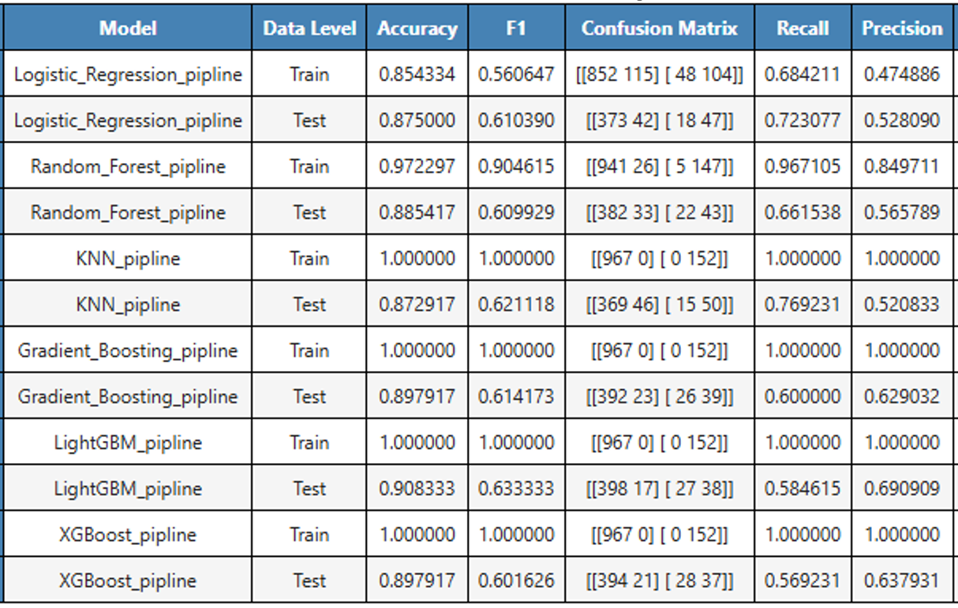
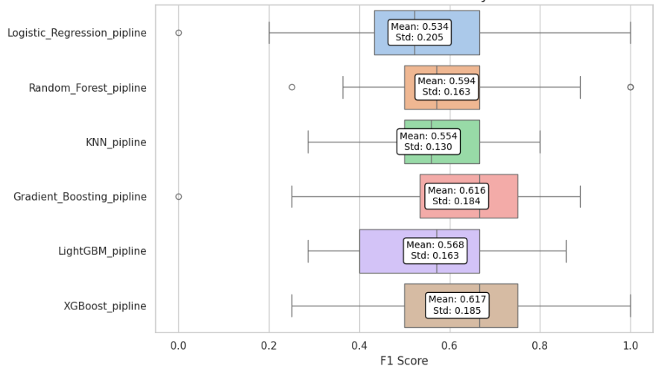
Multi Classifier Optimization & Cross Validation
To improve our model, we optimized six classifiers—Logistic Regression, Random Forest, KNN, Gradient Boosting, LightGBM, and XGBoost—using Optuna to maximize the F1 score across 100 trials.
LightGBM Performance: Highest F1 score of 0.633 and accuracy of 0.908, making it the most effective model.
Generalization Issues: Many models achieved perfect training scores but struggled with generalization, indicating potential overfitting.
Need for Further Tuning: Additional tuning is necessary to enhance performance on unseen data and improve generalization.
40-Fold Cross-Validation: Conducted on six models to assess performance and stability.
Performance Insights: XGBoost and Gradient Boosting achieved the highest mean F1 scores. All models showed varying levels of performance, indicating potential for improvement through further tuning.

Slide 9
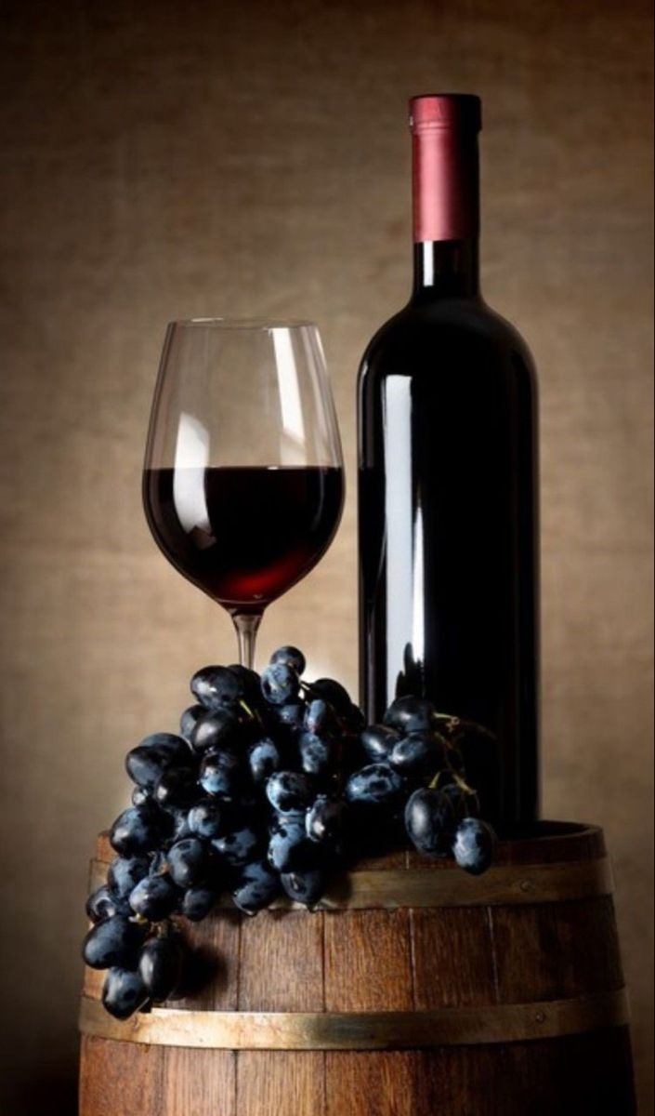

Ensemble Models
Overfitting
Perfect training scores in both cases indicate potential overfitting. Further tuning is needed to enhance generalization on unseen data and reduce the gap between training and test performance.
We explored two ensemble approaches using hard voting:
All 6 optimized models:
Perfect performance on training data
Test data: F1 score 0.629, Accuracy 0.904
Top 3 models (Logistic Regression, KNN, LightGBM):
Test data: F1 score 0.681, Accuracy 0.908
Confusion matrix: TN 389, FP 26, FN 18, TP 47
The 3-model ensemble outperformed individual classifiers and the 6-model ensemble, demonstrating improved generalization.

Slide 10
Conclusions & Future Work
Key Findings
Future Directions
01
Feature transformation reduced outliers by 45% and improved model performance.
01
Investigate impact of dropping correlated features.
02
Oversampling strategies effectively addressed class imbalance.
02
Improve classification of mid-range wines.
03
Ensemble approach outperformed individual models (Best F1 score: 0.6812)
03
Conduct deeper feature importance analysis across models.
04
Models struggled with mid-range wines (rated 6-7).
04
Further optimize ensemble model parameters.
While significant progress was made in predicting wine quality, challenges remain in classifying borderline cases, presenting opportunities for model refinement and feature analysis.

Slide 11

Thank you for joining us on this journey to predict wine quality! We hope you enjoyed this project as much as we did.
See you at our next project—cheers!

